Slide 1
Lecture 6
Trees

Slide 2


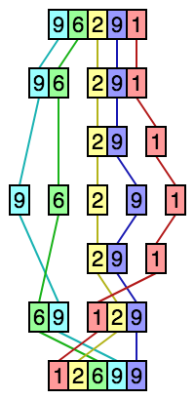

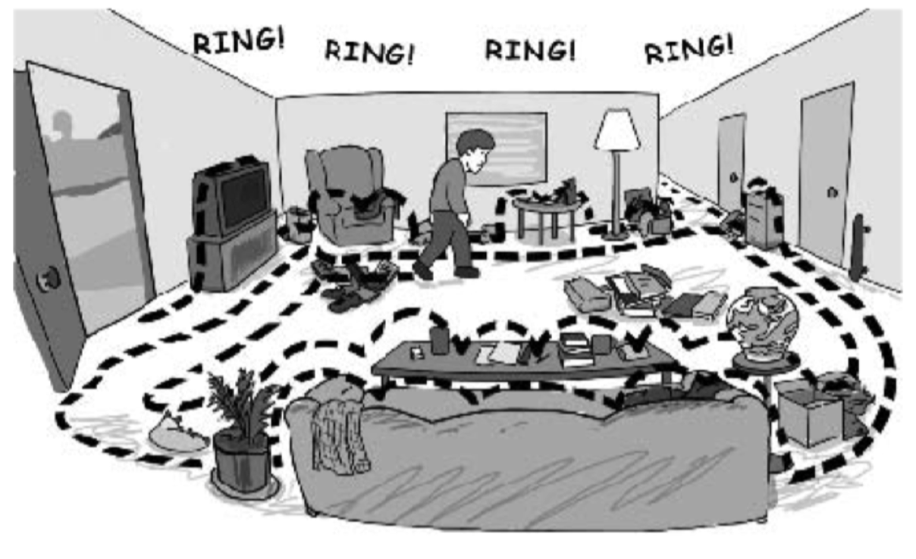
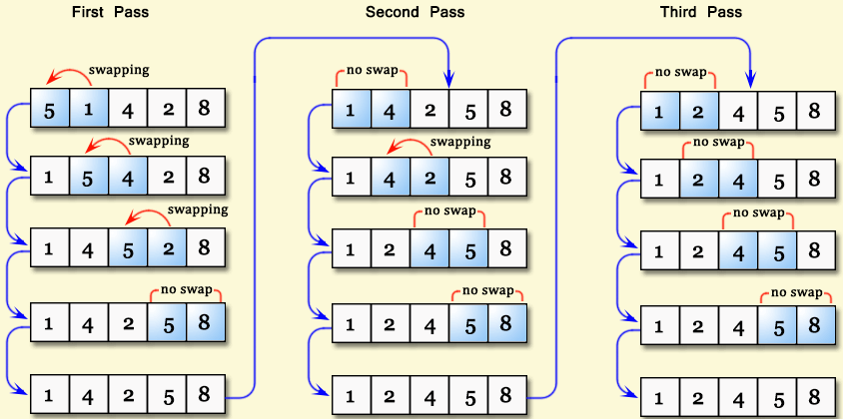
Identify the following data structures & algorithms

Slide 3
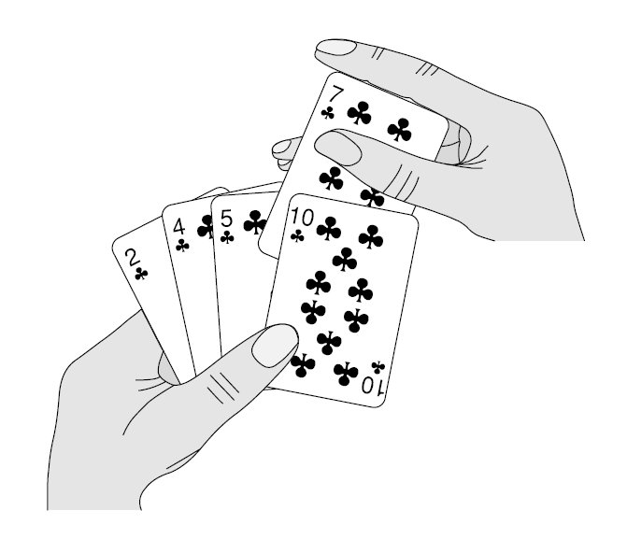
Data Structures & Algorithms
Data Structures:
Stacks
Queue
Linear Queue
Circular Queue
List
Singly Linked List
Algorithms
Searching
Binary Search
Linear Search
Sorting
Bubble Sort
Selection Sort
Insertion Sort
Merge Sort

Slide 4

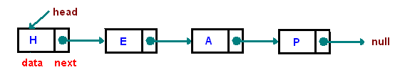
Linked List (Singly)
Add/remove to tail, head, middle

Slide 5
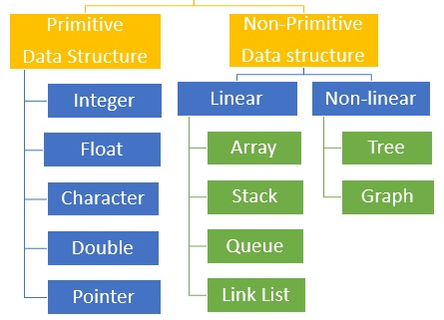
Data Structures

Slide 6



Tree Data Structure
Extension of Linked List structure:
• Each node connects to multiple nodes
• Example usages include
File systems, Java class hierarchies

Slide 7
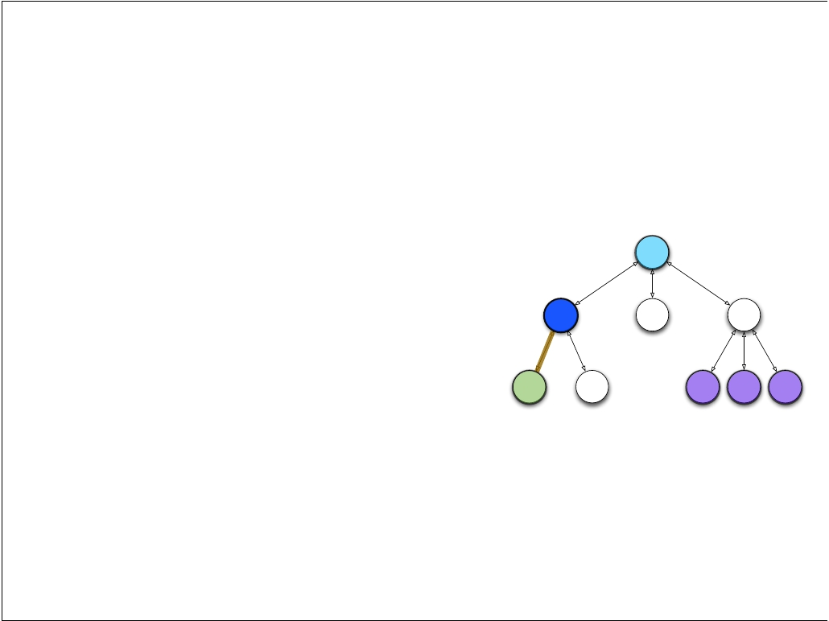
Tree Terminology
Just like Linked Lists, Trees are collections of nodes
Conceptualize trees upside down (like family trees)
the top node is the root
nodes are connected by edges
edges deﬁne parent and child nodes
nodes with no children are called leaves

Slide 8
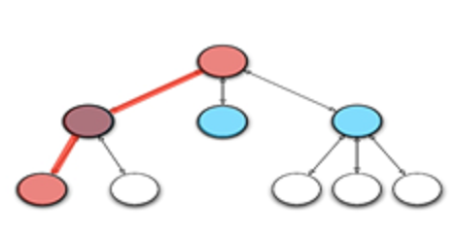
Tree Terminology
Nodes that share the same parent are siblings
A path is a sequence of nodes such that the next node in the sequence is a child of the previous

Slide 9
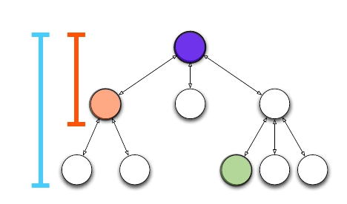
Tree Terminology
a node's depth is the length of the path from root
the height of a tree is the maximum depth
if a path exists between two nodes, one is an ancestor and the other is a descendant

Slide 10
Tree Implementation :-
Many possible implementations
One approach: each node stores a list of children
public class TreeNode<T> {
T nodeValue;
Collection<TreeNode<T>> myChildren;
}

Slide 11
Tree Traversal :-
A traversal visits the nodes of a tree in a systematic manner
Suppose we want to print all nodes in a tree. What order should we visit the nodes?
Preorder- read the parent before its children
Postorder- read the parent after its children
Notes:
Angel bracket/ type parameter

Slide 12
Tree Traversal : Preorder
// parent before children
preorder(node myChildren)
print(myChildren)
for child : myChildren
preorder(child)
20
70
50
30
60
90
100
80
Notes:
print a structured document

Slide 13
Tree Traversal : Preorder
Start from the root, visit the node first then
move to the left as possible and then to the right child up until the first crossroad and repeat the VLR* process.
* If we denote the task of visiting the root by V, traversing left subtree by L and that of right subtree by R
Notes:
print a structured document

Slide 14
Tree Traversal: Preorder
• start at the root (20)
• visit the root which prints 20 on the screen
• then move to the left child
• if the left child is null move to the right child
• repeat the VLR steps till all nodes are visited
20
70
50
30
60
90
100
80
Notes:
20 50 30 80 60 70 90 100

Slide 15
Tree Traversal: Postorder
Postorder Traversal (LRV):-
Start from the root, move to the left as far as
possible and then to the right and finally print the value ones the L and R traversing is over.
Notes:
compute space used by files in a directory and its subdirectories

Slide 16
Tree Traversal: Postorder
// parent after children
postorder(node myChildren)
for child : myChildren
postorder(child)
print(myChildren)
20
70
50
30
60
90
100
80
Notes:
compute space used by files in a directory and its subdirectories

Slide 17
start at the root (20)
move through the left subtree until its null (30).
• then move through to the right child (80)
• if both left and right children are null or has been visited, visit the node.
Print 80 on the screen.
• Continue the LRV process up until all the nodes are visited.
20
70
50
30
60
90
100
80
Notes:
30 80 50 60 20 90 70 100

Slide 18
Binary Tree
• Nodes can only have two children:
left child and right child
• Simpliﬁes implementation and logic
public class BinaryNode<T> {
T element;
BinaryNode<T> left;
BinaryNode<T> right;
}
• Provides new inorder traversal

Slide 19
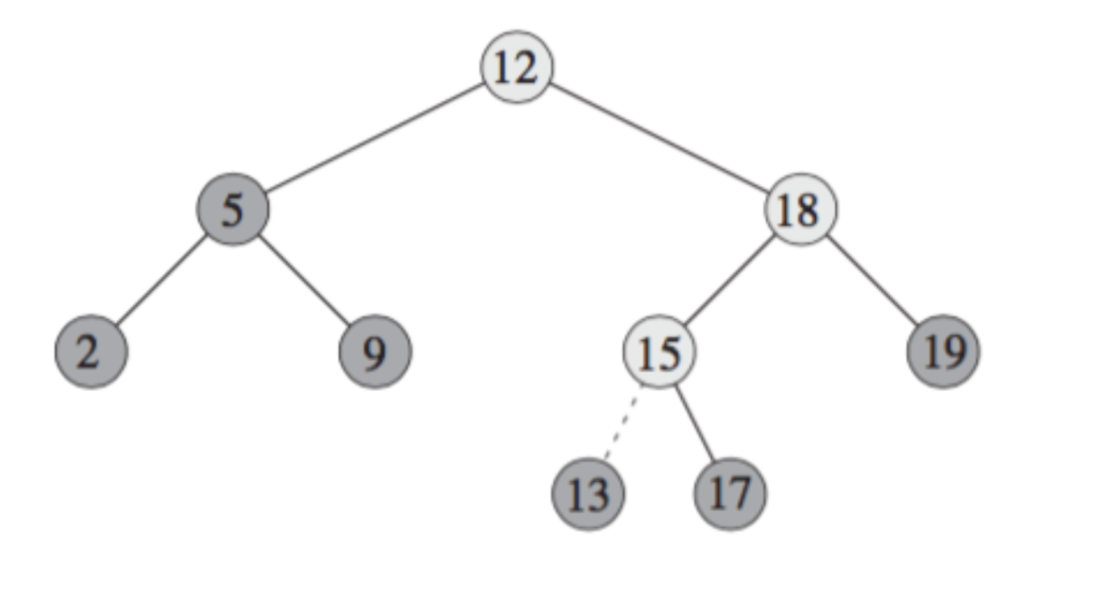
Binary Search Tree (BST)
Each node contains one key
Left sub-tree are less then the key in its parent node, in short L < P;
Right sub-tree are greater the key in its parent node, in short P < R;
No duplicate keys
Notes:
https://www.cs.cmu.edu/~adamchik/15-121/lectures/Trees/trees.html

Slide 20
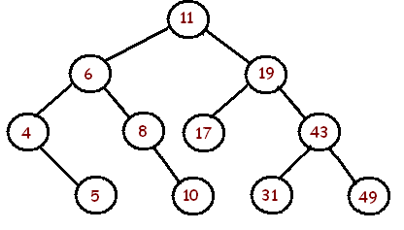
Exercise (Binary Tree)
Problem: Draw a binary search tree by inserting the following numbers from left to right.
11, 6, 8, 19, 4, 10, 5, 17, 43, 49, 31
Notes:
http://fiftyexamples.readthedocs.io/en/latest/algorithms.html

Slide 21
• Read left child, then parent, then right child
• Essentially scans whole tree from left to right
• inorder(node x)
inorder(x.left)
print(x)
inorder(x.right)
A binary tree is full if each node has 2 or 0 children
• A binary tree is perfect if it is full and each leaf is at the same depth

Slide 22
Tree Traversal :- Inorder
• Read left child, then parent, then right child
• Essentially scans whole tree from left to right
• inorder(node x)
inorder(x.left)
print(x)
inorder(x.right)

Slide 23
Inorder Traversal (LVR):- Start from the root traverse the left subtree as far as possible then visit the node traverse the right child up until the first crossroad and repeat the LVR process again.
• start at the root (20)
• since root has a left subtree move to the left child (50)
• keep on moving until the left child (30) is null
• since L is done start V which prints 30 on the screen
• then move to the right child (80)
• repeat the LVR steps till all nodes are visited

Slide 24
Applications:
arithmetic expressions
decision processes
searching

Slide 25
Expression Trees
Expression Trees are yet another way to store mathematical expressions
Binary tree associated with an arithmetic expression
 internal nodes: operators
external nodes: operands
Example: arithmetic expression tree for the following expressions
(2 × (a −1) + (3 × b))
((x + y) * z)/300

Slide 26
Decision Trees
It is often useful to design decision trees
Binary tree associated with a decision process
internal nodes: questions with yes/no answer
external nodes: decisions
Example: dining decision
Hungry?
OK
Hv Mny?
FR
Tea

Slide 27
For any tree, T, define the following
path in T
height of a node in T
depth of a node in T
height of T
depth of T
external node
internal node
leaf

Slide 28
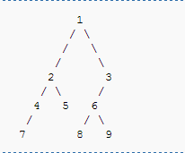
Find output of:
Preorder
Postorder
Inorder Traversal

Slide 29
Thank You

